Slide 1



FinTech BI
View in Power BI
Last data refresh:
3/4/2025 4:11:57 PM UTC
Downloaded at:
3/4/2025 4:13:21 PM UTC

Slide 2
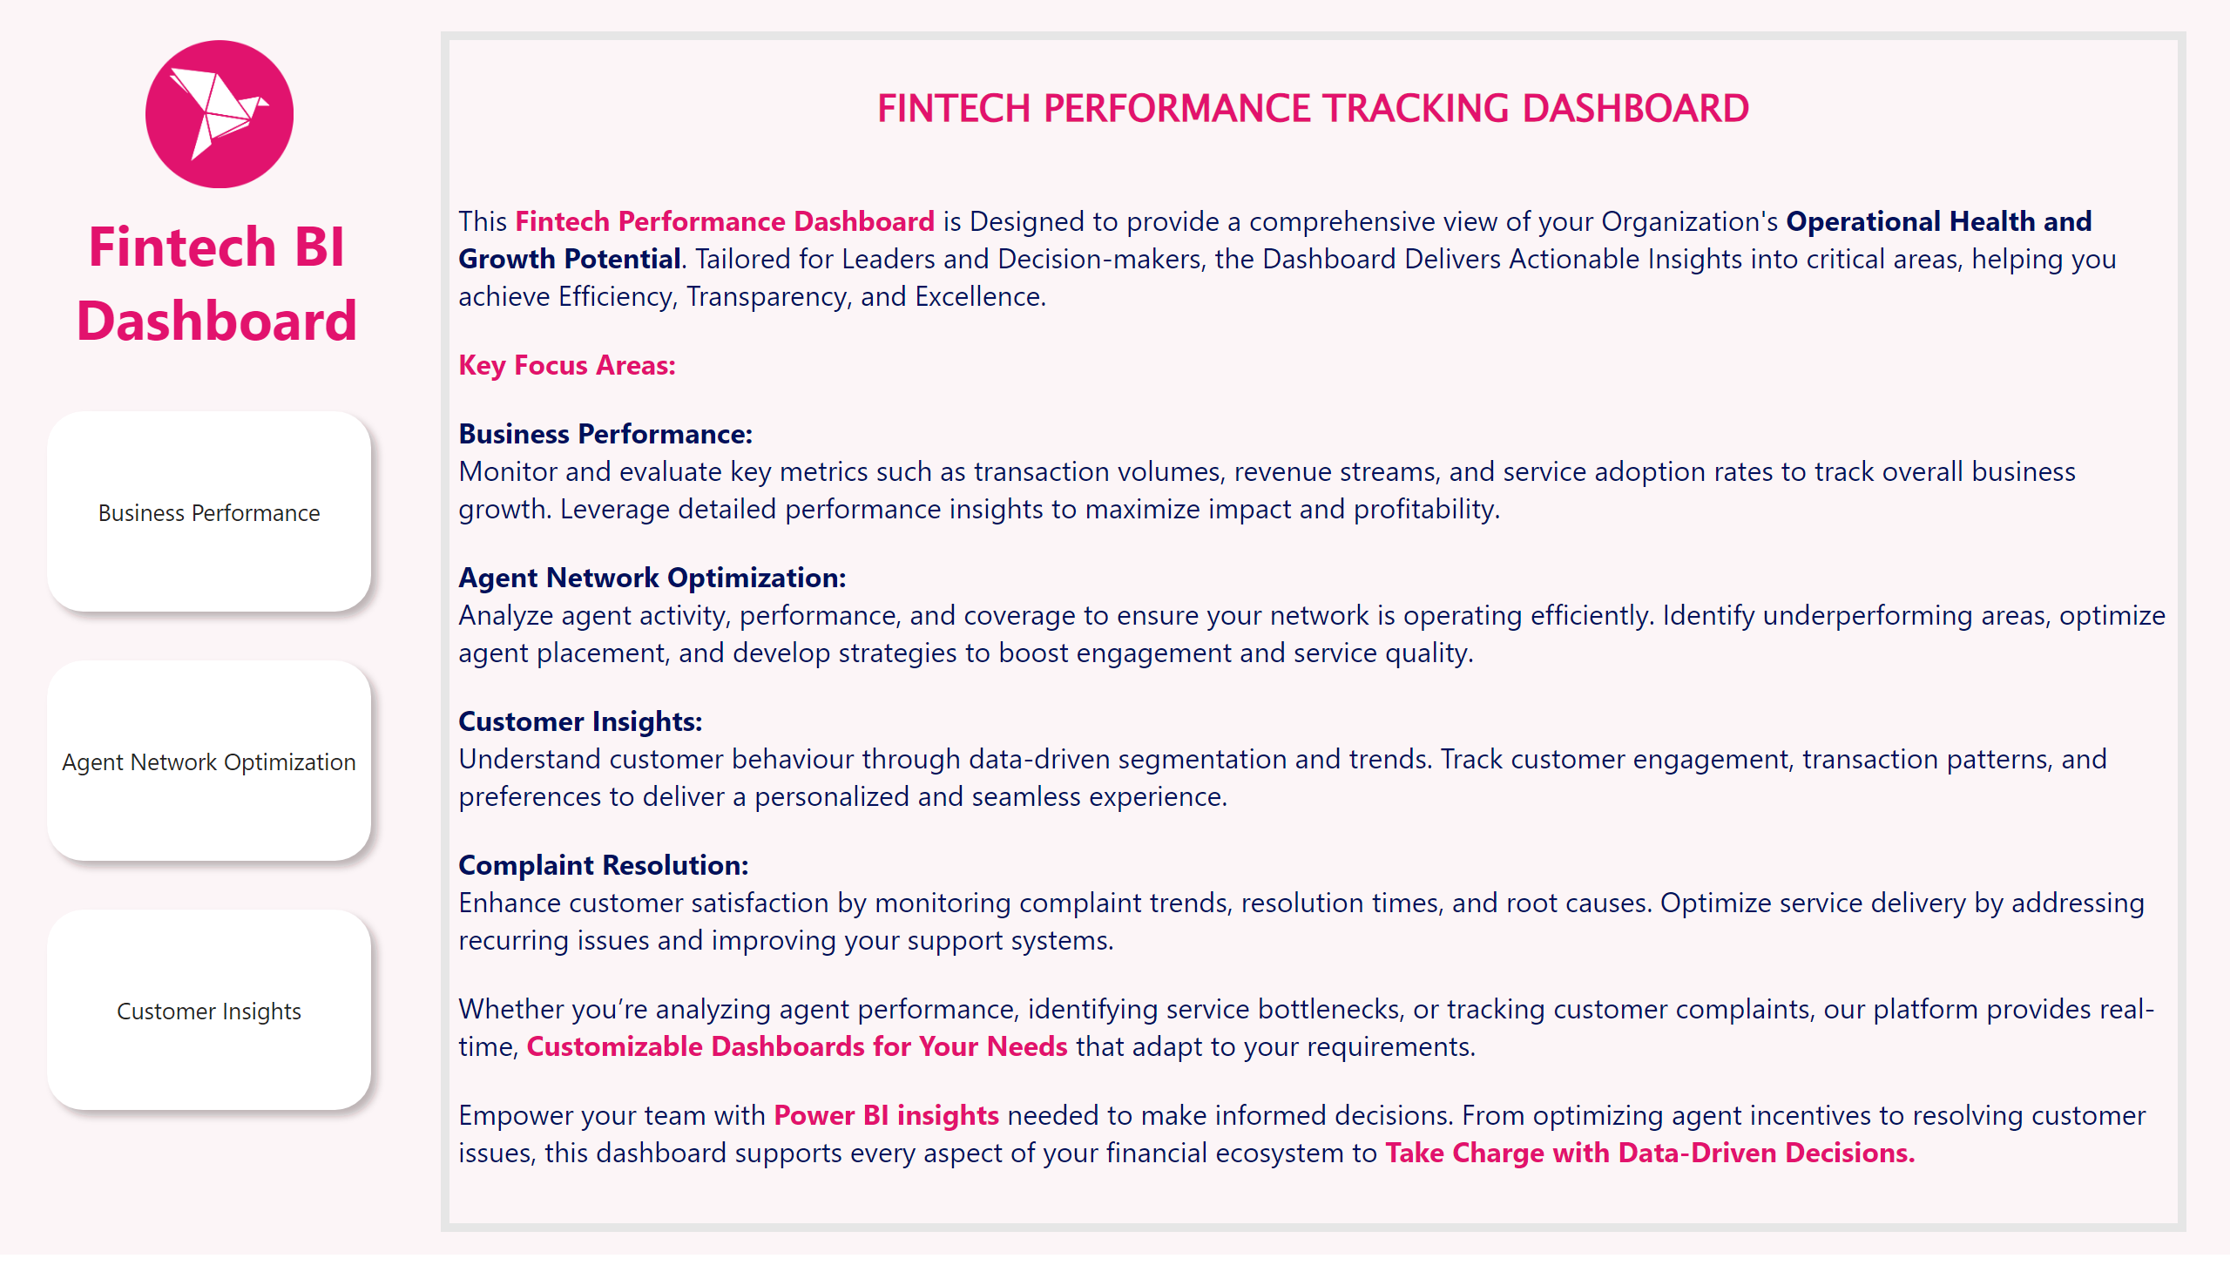
Overview
Notes:
image
No alt text provided
textbox
No alt text provided
textbox
No alt text provided
pageNavigator
No alt text provided

Slide 3
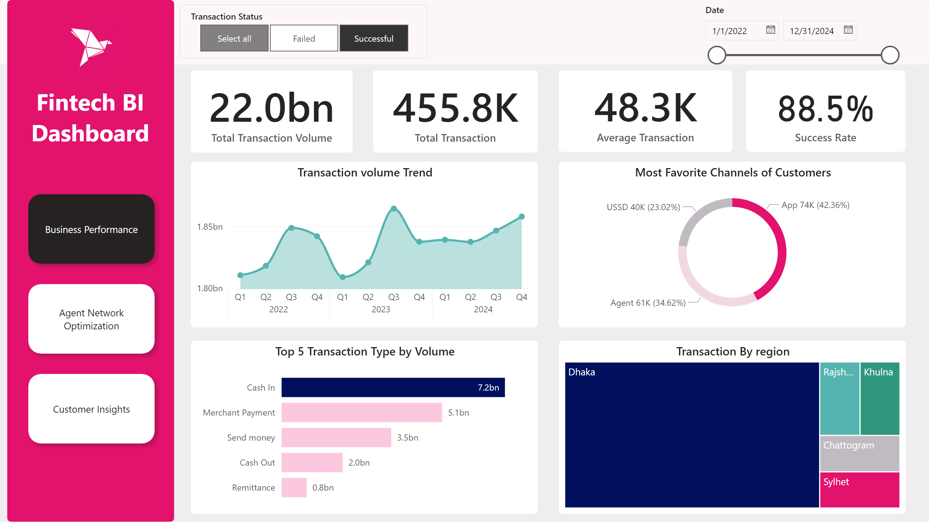
Business Performance
Notes:
card
No alt text provided
shape
No alt text provided
shape
No alt text provided
image
No alt text provided
textbox
No alt text provided
slicer
No alt text provided
slicer
No alt text provided
pageNavigator
No alt text provided
Transaction volume Trend
No alt text provided
card
No alt text provided
card
No alt text provided
card
No alt text provided
Most Favorite Channels of Customers
No alt text provided
Top 5 Transaction Type by Volume
No alt text provided
Transaction By region
No alt text provided

Slide 4
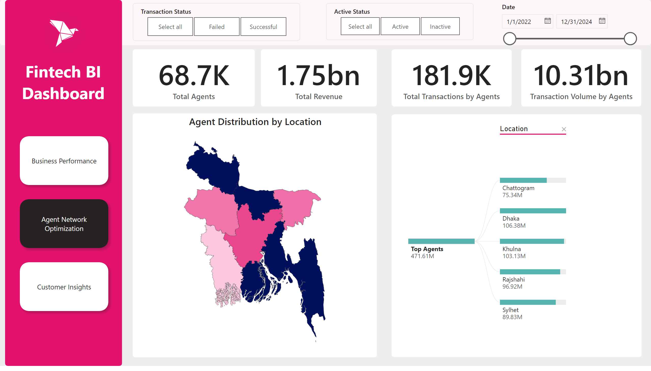
Agent Network Optimization
Notes:
shape
No alt text provided
shape
No alt text provided
image
No alt text provided
textbox
No alt text provided
pageNavigator
No alt text provided
card
No alt text provided
card
No alt text provided
card
No alt text provided
card
No alt text provided
slicer
No alt text provided
Agent Distribution by Location
No alt text provided
decompositionTreeVisual
No alt text provided
slicer
No alt text provided
slicer
No alt text provided

Slide 5
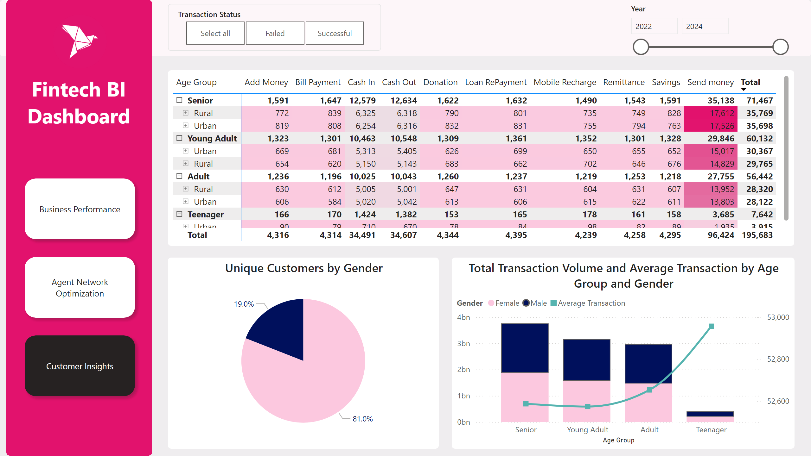
Customer Insights
Notes:
shape
No alt text provided
shape
No alt text provided
image
No alt text provided
textbox
No alt text provided
slicer
No alt text provided
pageNavigator
No alt text provided
pieChart
No alt text provided
Total Transaction Volume and Average Transaction by Age Group and Gender
No alt text provided
pivotTable
No alt text provided
slicer
No alt text provided

